Slide 1
Devops Essential
Venkatachalam Mani - 532146

Slide 2
AGENDA
1. Overview of Jenkins and CloudBees CI Capapbilities - Theory
2. Plugins Installation and Integration - Demo + theory
3. PipeLine fundamental ,Parameters, and Environment Variables Creation:(Decelrative Pipeline, Groovy Shared Library) Demo + theory
4. CloudBees CI enterprise Capapbilities (Pipeline template, Pipeline Policy and Configuration as Code) Theory
5. CloudBees CD/RO - Feature walkthrough - theory

Slide 3
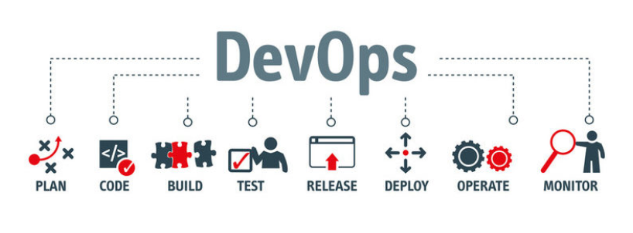
Devops Overview
DevOps is a set of practices that combines software development (Dev) and information-technology operations (Ops) which aims to shorten the systems development life cycle and provide continuous delivery with high software quality.
DevOps is not a tool, a standard or a product, it is a culture and practice.

Slide 4
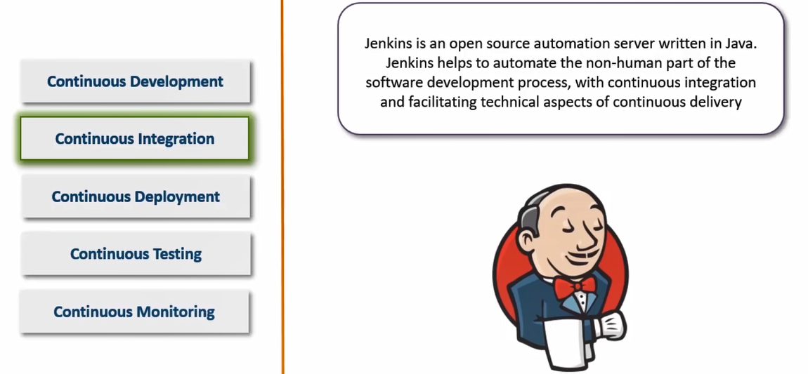
Continuous Integration

Slide 5
Thank You!

